Slide 1
Slack Guide

Slide 2
If you have any questions...
We made a Slack workspace where you can ask any questions. Please join!
Link : https://join.slack.com/t/compslackworkspace/shared_invite/zt-3sige3337-wxHzLLndBXLHOdGwR6Ho~Q
If the link doesn’t work, send an email to TA.
We will provide a separate slide that guides you how to use Slack.

Slide 3
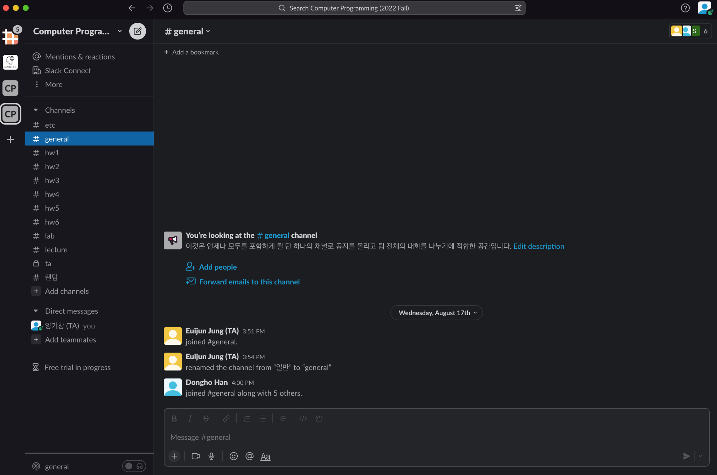
Set your name
Click the profile button
Click!

Slide 4
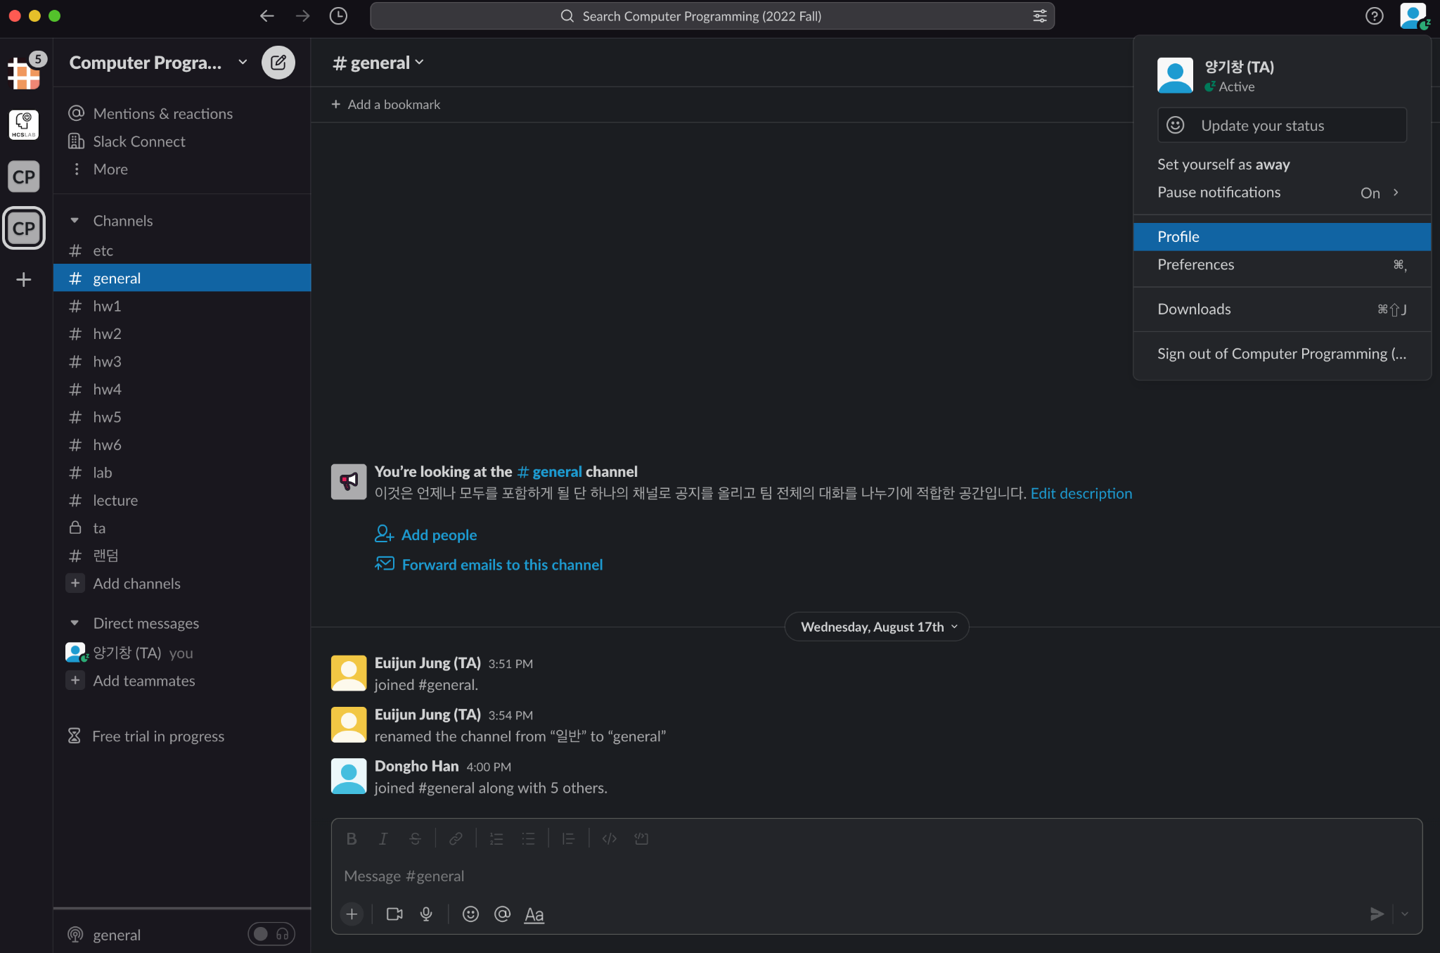
Set your name
Click “Profile”

Slide 5
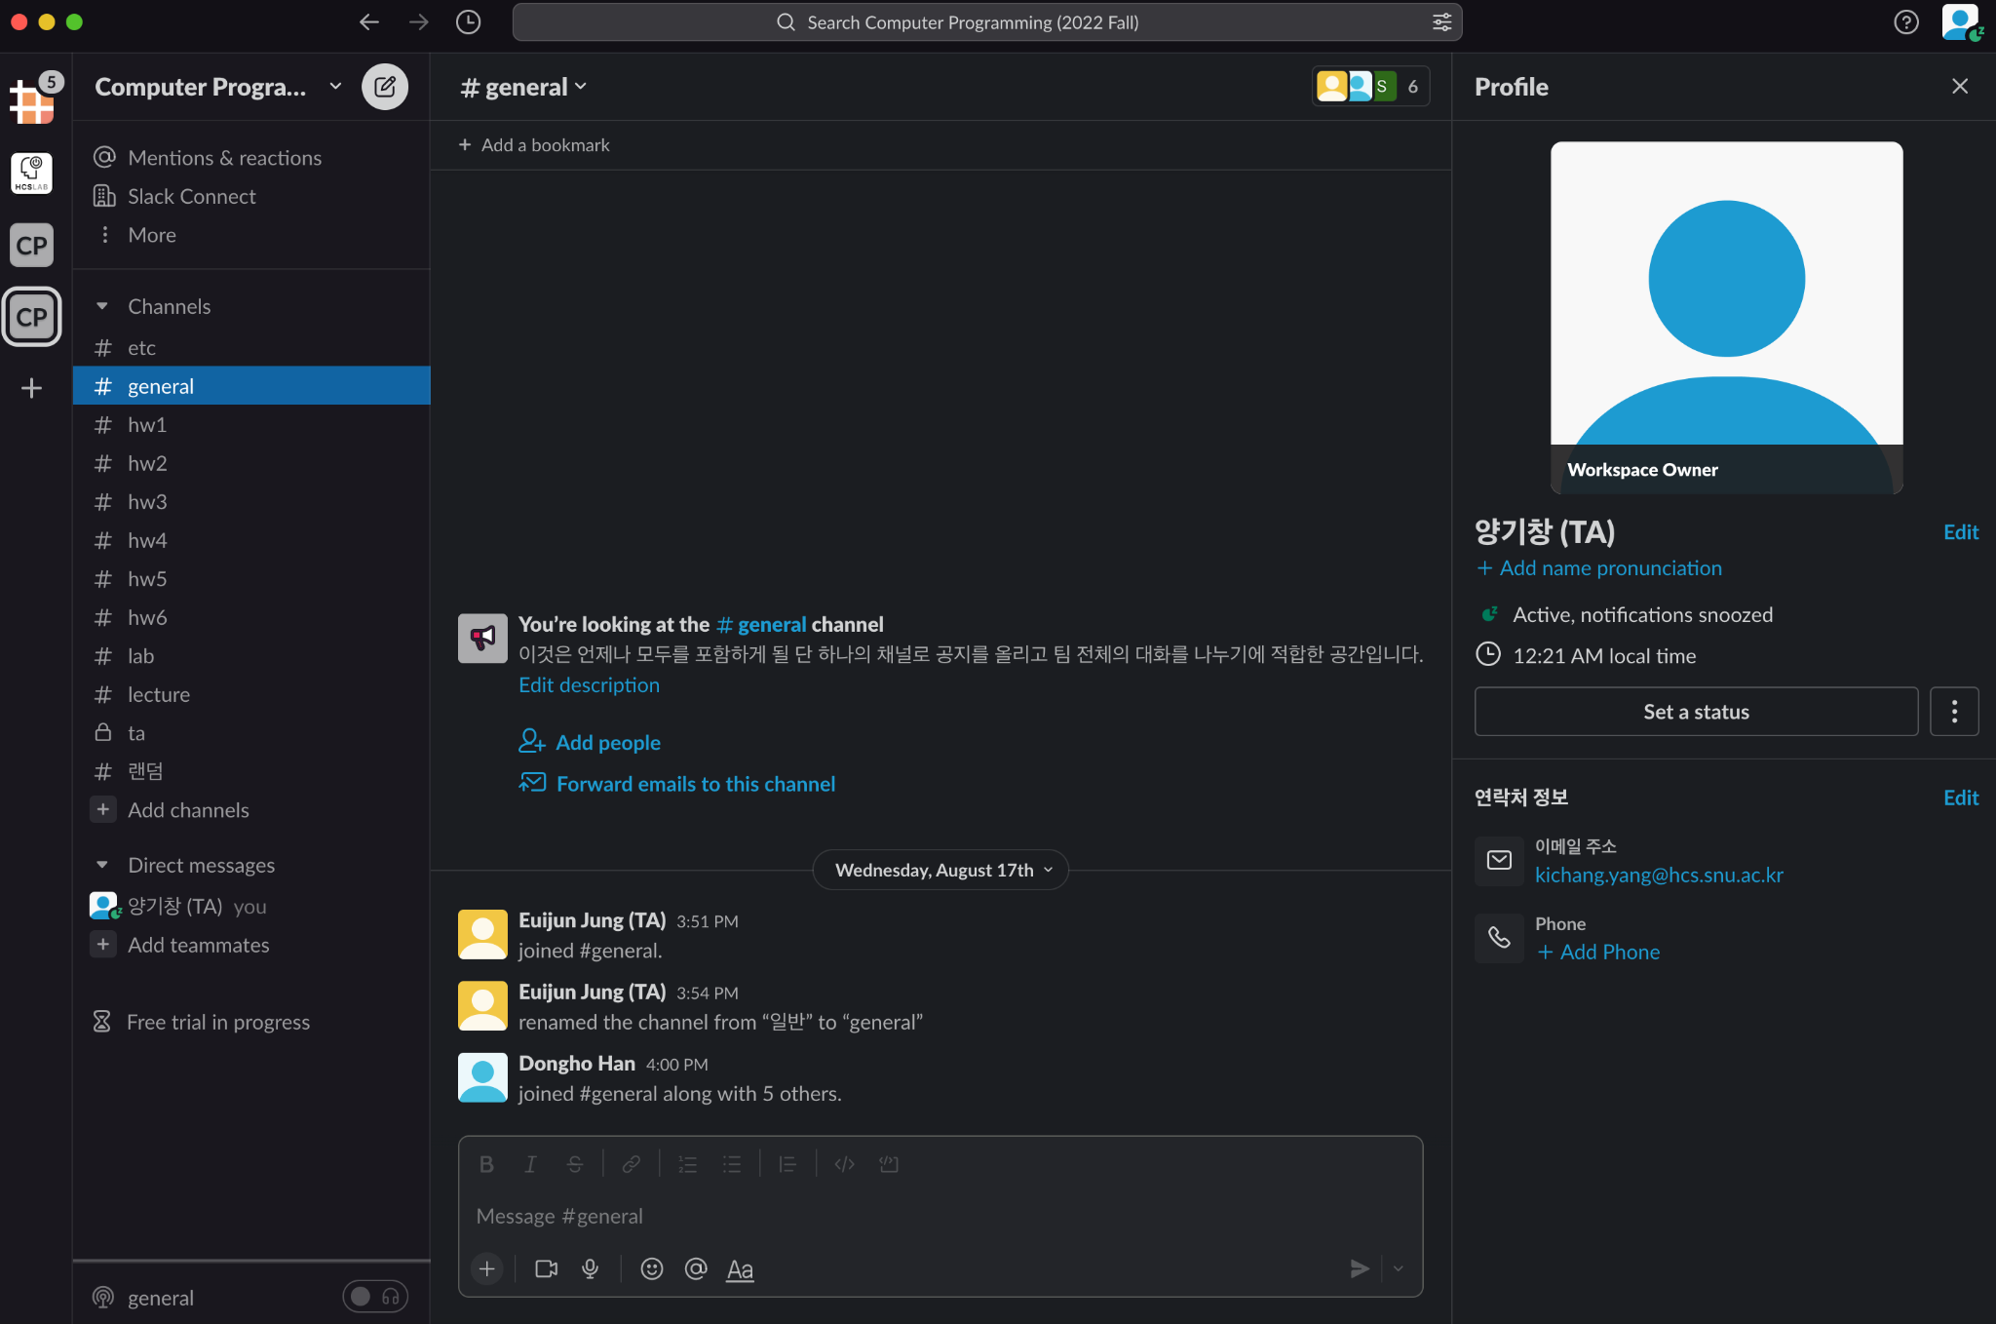
Set your name
Click “Edit”

Slide 6
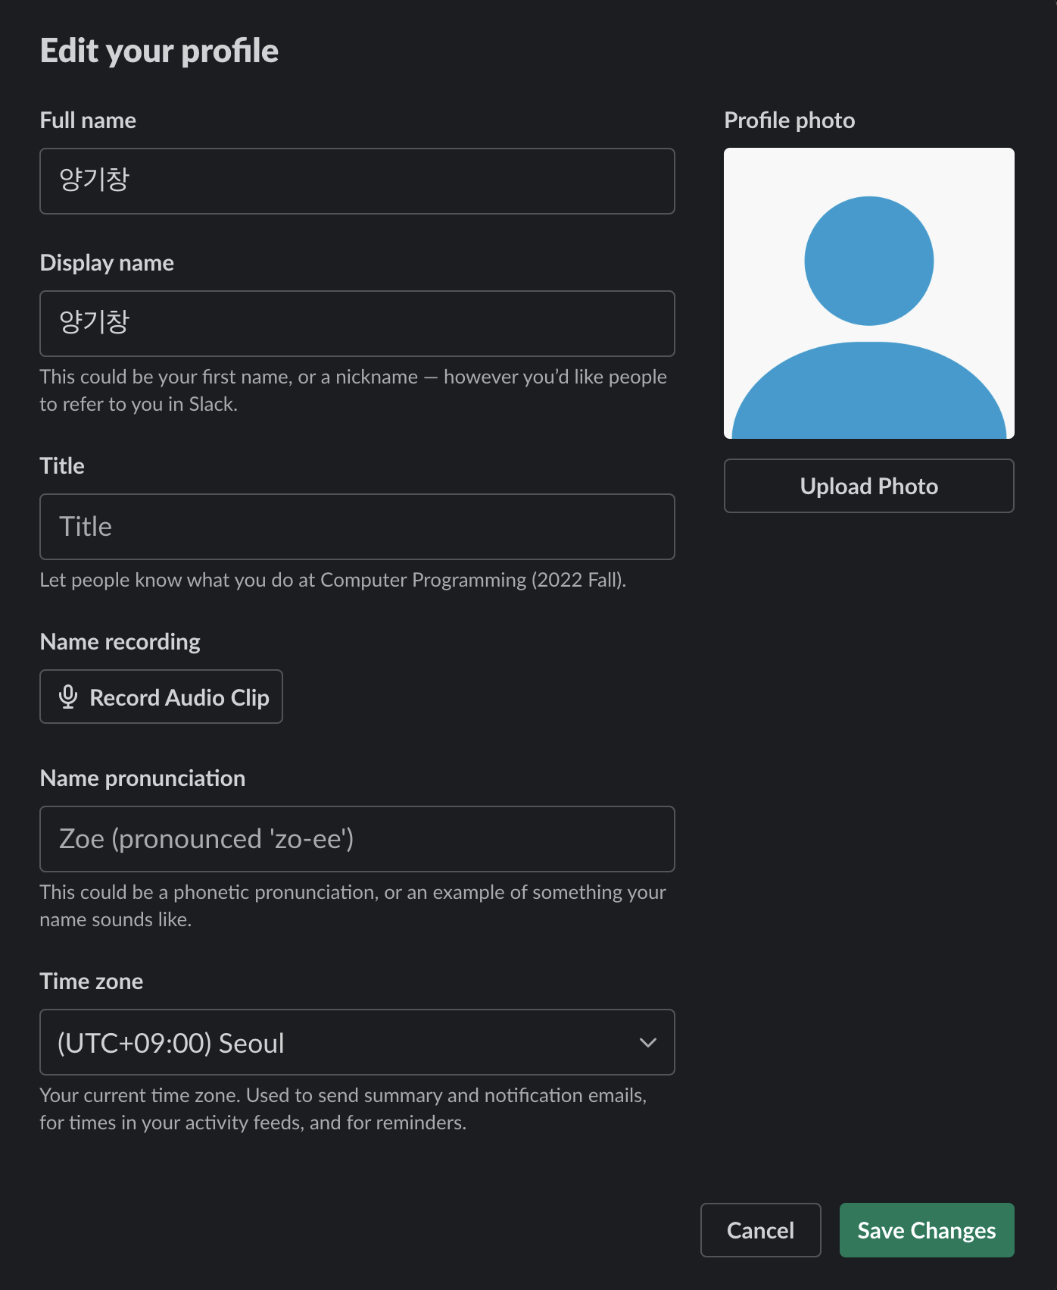
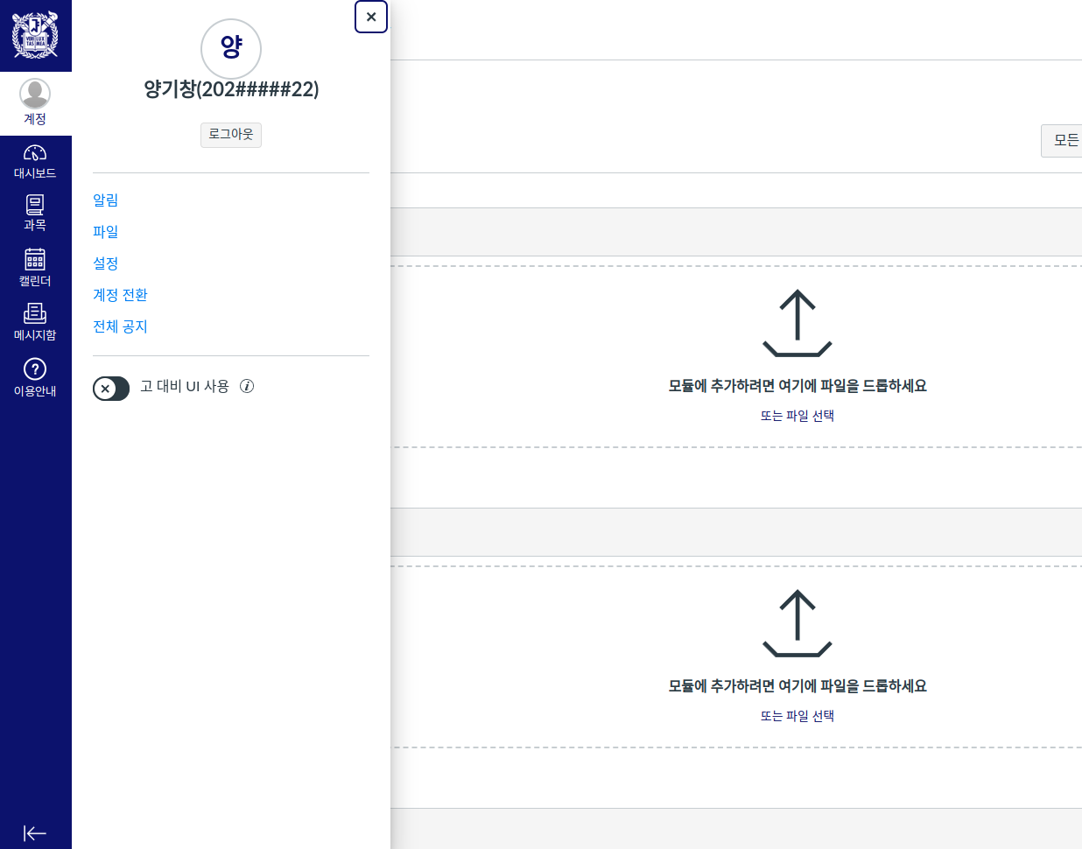
Set your name
Change Display name to be same as your name in ETL. Ex) 양기창
Click!

Slide 7
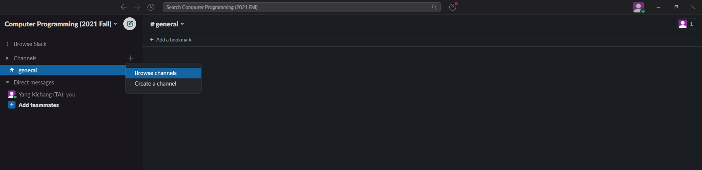
Join channels
Click “+” sign
Click “Browse channels”

Slide 8
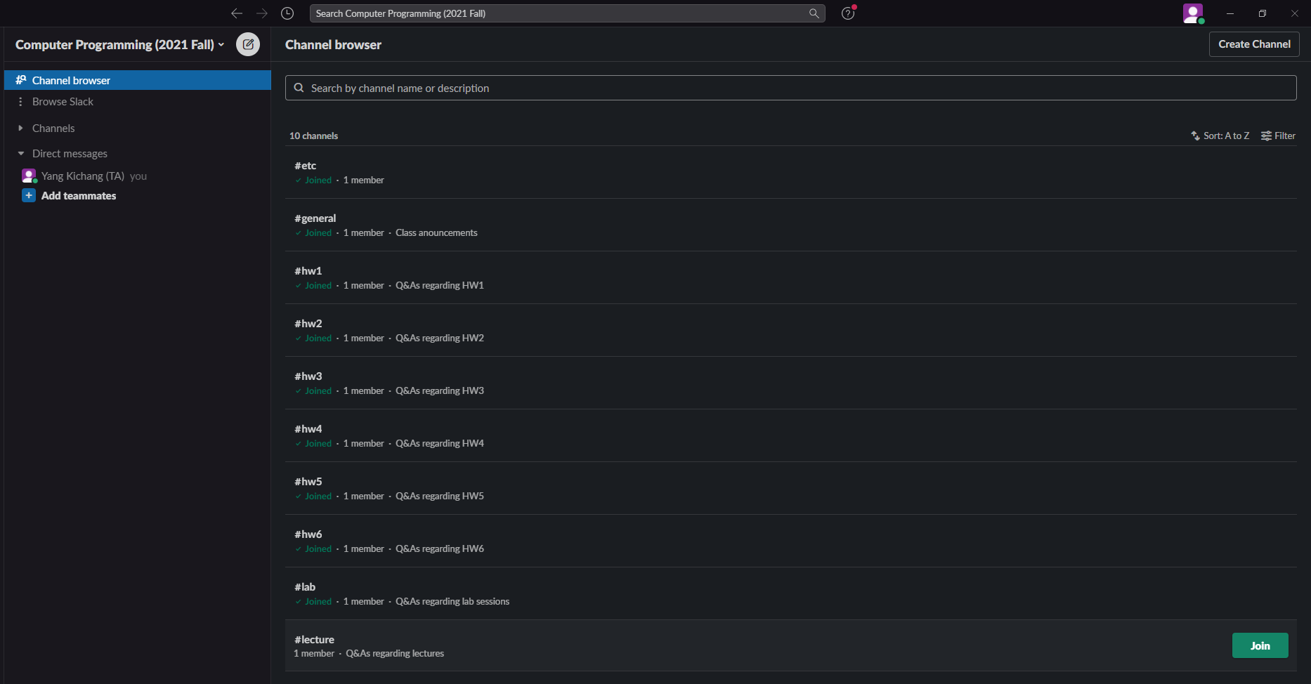
Join channels
Join every channels you can see
#general, #lab, #lecture, #hw1 ~ #hw6, #etc

Slide 9
Channel usage
If you have any questions, use the appropriate channel to ask. TAs will answer the questions.
Channel usage
#general: Class announcements (only TAs have the write permission)
#lecture: Q&As regarding lectures
#lab: Q&As regarding lab sessions
#hw1 ~ #hw6: Q&As regarding homework1 ~ homework6
#etc: Other Q&As not included in the above

Slide 10
Channel usage
It is highly recommended that students answer each other’s questions. TAs will of course help too! Participation points will be given to students who actively participates.
For private questions, send emails to TAs.

